Slide 1
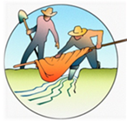
The Acequia Community – Colorado’s First Settlements
Grades 3-5
Picture and Map Library
This library allows teacher to show the visual resources in this lesson using their overhead projector.

Slide 2
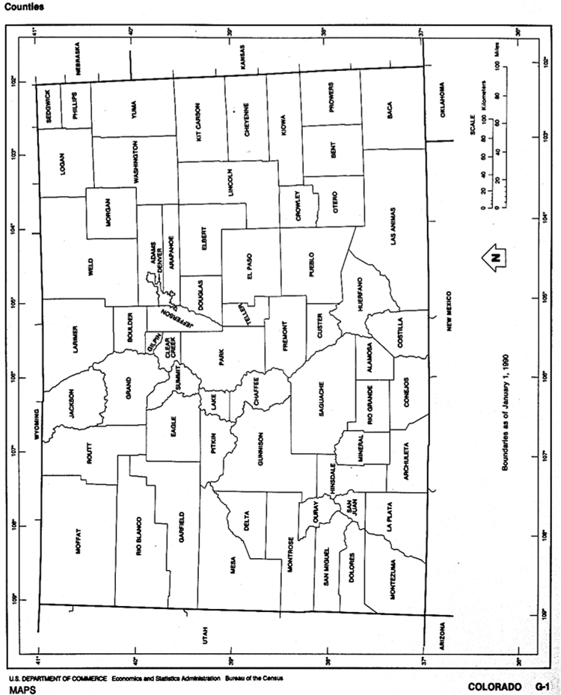

Slide 3
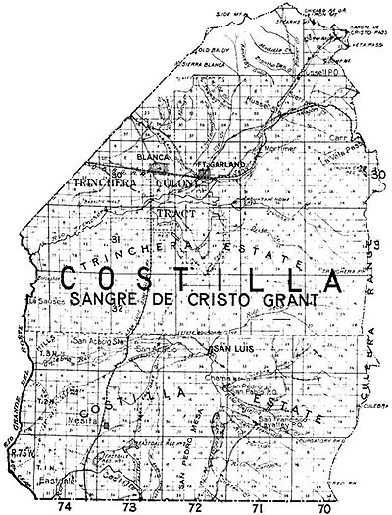
Photo courtesy of https://adamjamesjones.com/2012/05/29/charles-don-carlos-beaubien-trader-judge-pioneer/

Slide 4
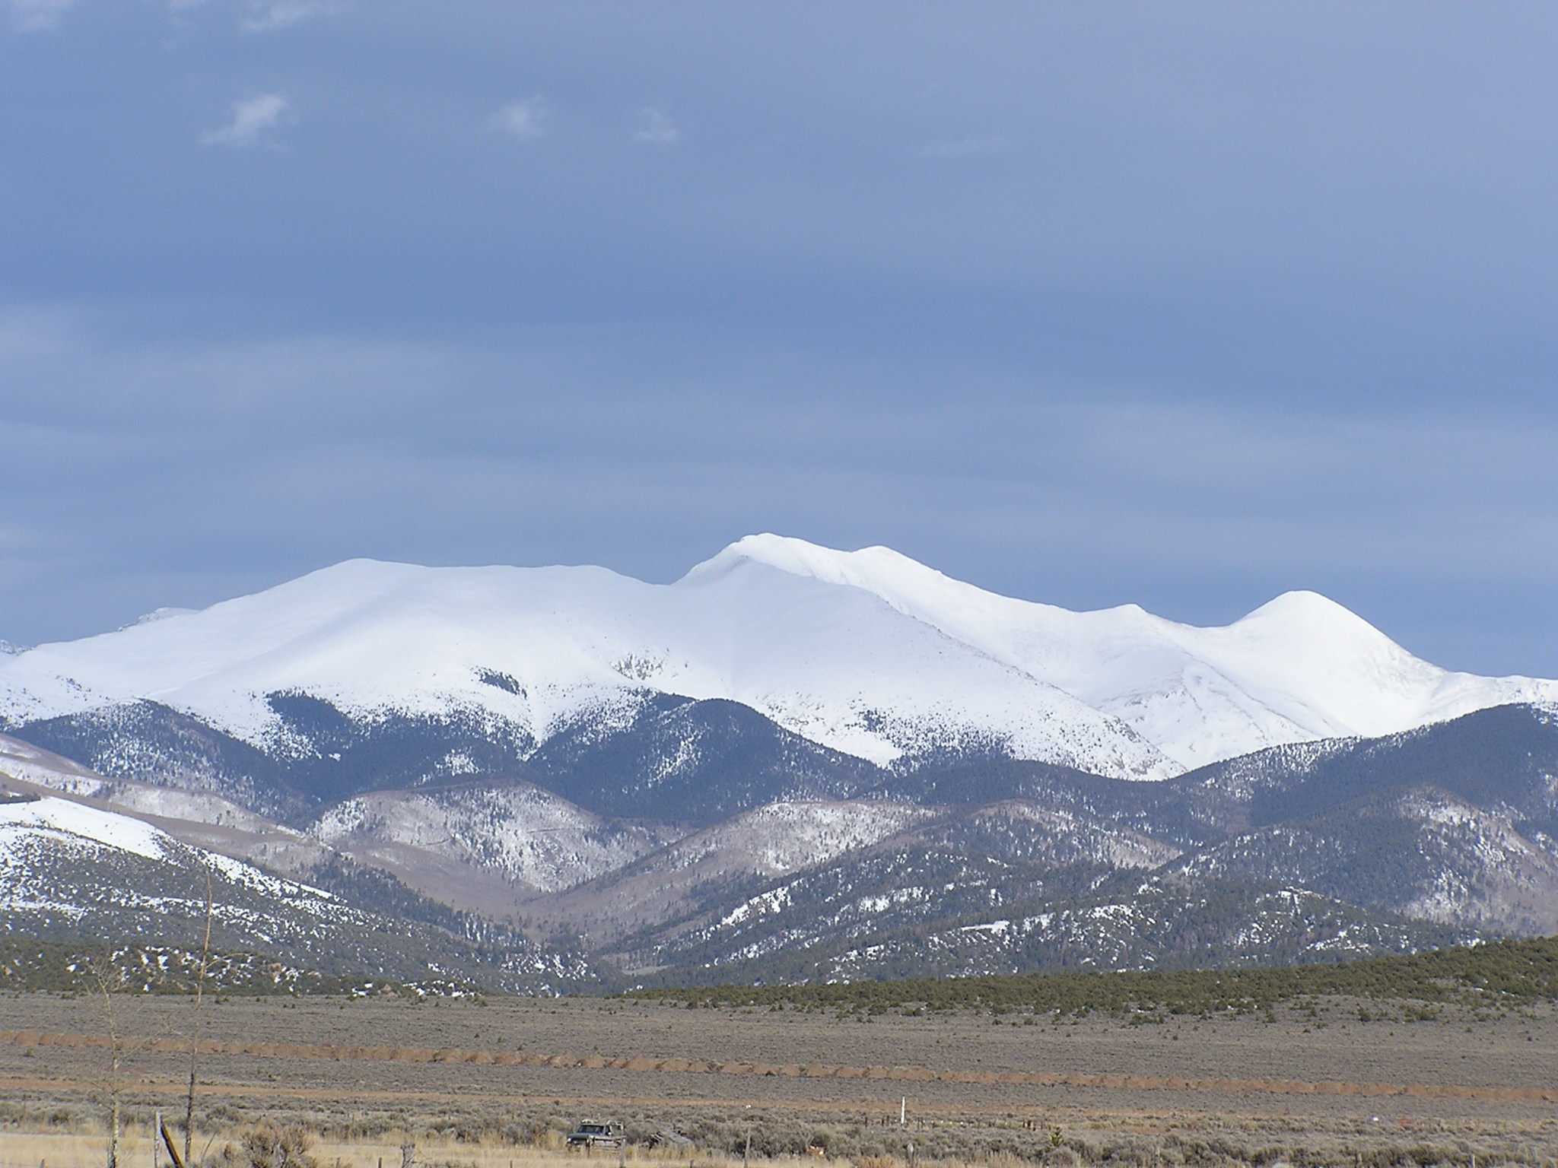
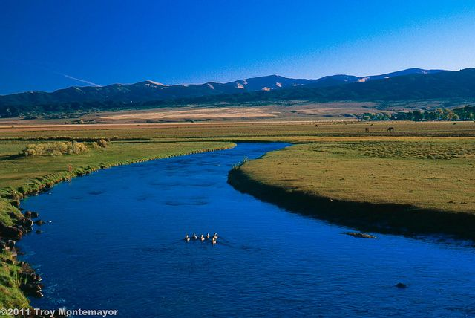
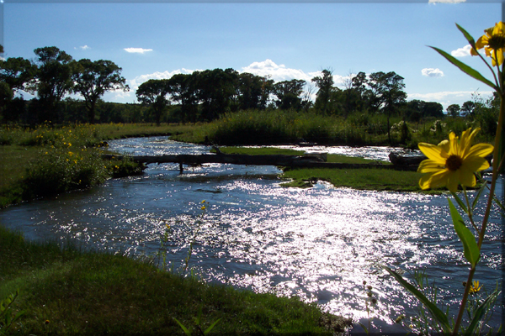
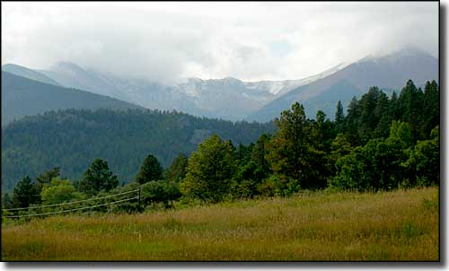
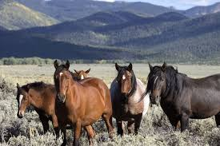
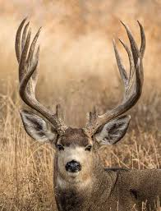
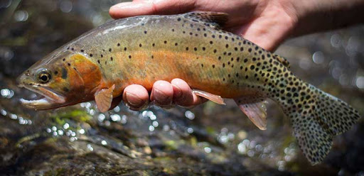
Scenes from the Culebra Photos Courtesy of www.istockphotos.com

Slide 5
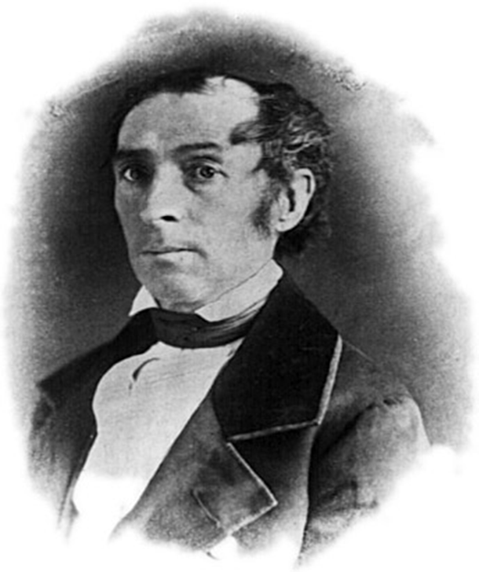
Photo Courtesy of www.https://i2.wp.com/adamjamesjones.com/wp-content/uploads/2012/05/memorias_beaubien1.jpg

Slide 6
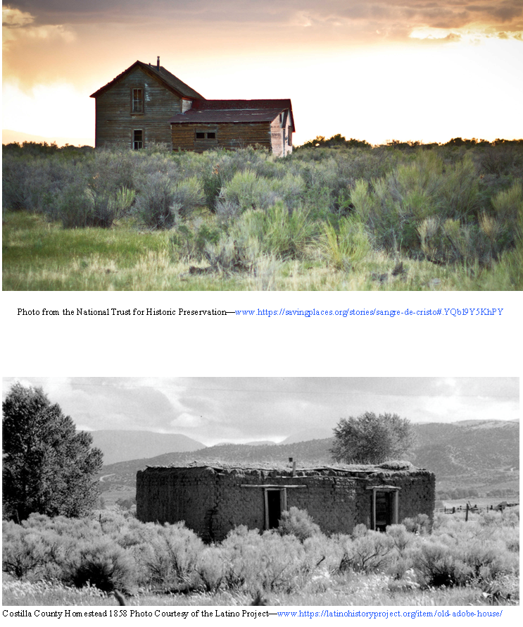

Slide 7
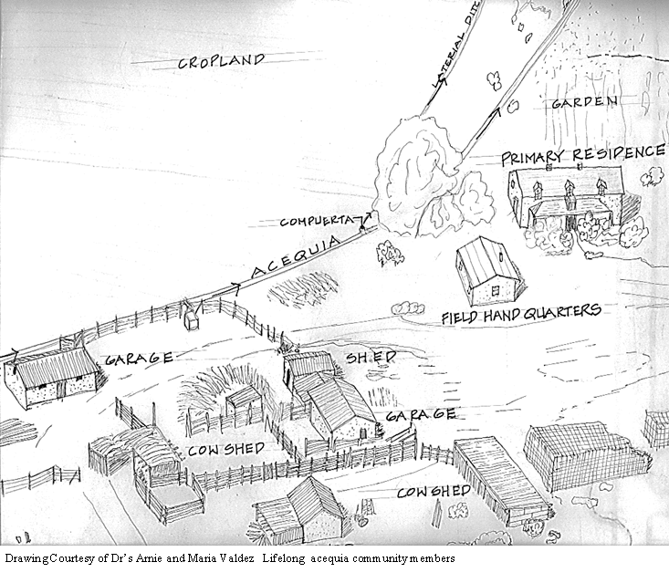

Slide 8
